Slide 1
Shogi Java Project
Jace Kramer, Travis Clark, Nicholas Gilleran,
Nate Benson, Luke Carter
A 2-player Java implementation of the game Shogi

Slide 2
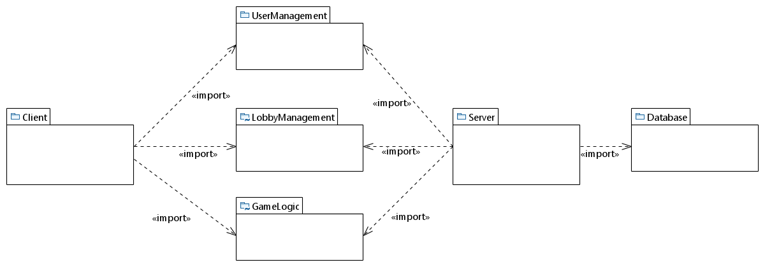
Package Diagram
Jace Kramer
Nate Benson
Luke Carter
Jace Kramer
Nate Benson
Jace Kramer
Travis Clark
Nicholas Gilleran

Slide 3
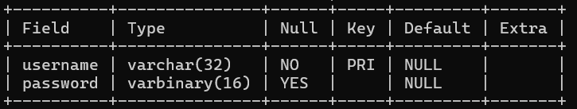
Database Design Diagram
username
password
User

Slide 4
Functional Requirement Example
User can move their pieces according to Shogi rules, including standard moves, captures, and piece promotions. (Move, Capture Piece, Promote Piece)

Slide 5
Use Case Description Example
Capture Piece - Actors: User
Related Use-Case:
Extension-Of: Move. Extension Point Occurs at Step 5
The system removes the opponent’s piece that the user’s piece was placed on top of from the board
The system places the unpromoted version of the opponent's piece into the inventory of the user
Entry Condition: The User moved their piece onto an opponent’s piece
Move - Actors: User
System starts the user’s turn timer
User selects the piece in their inventory or on the board that they would like to move
The system displays all of the valid moves for the selected piece
User selects a valid place on the board for the piece to be moved to
System updates the visuals of the board with the new placement of the user’s piece
Entry Condition: It is the user’s turn in an active game with an opponent
Exit Condition: User finishes their movement and the turn is passed to the opposing player
Promote Piece - Actors: User
Related Use-Case:
Extension-Of: Move. Extension Point Occurs at Step 5
The system prompts the user to ask if they would like to promote their moved piece
The user selects whether they would like to promote their piece or not
If yes is chosen, The system replaces the moved piece with the promoted version of the piece on the board
Entry Condition: The User moved their piece onto a square in the promotion zone

Slide 6
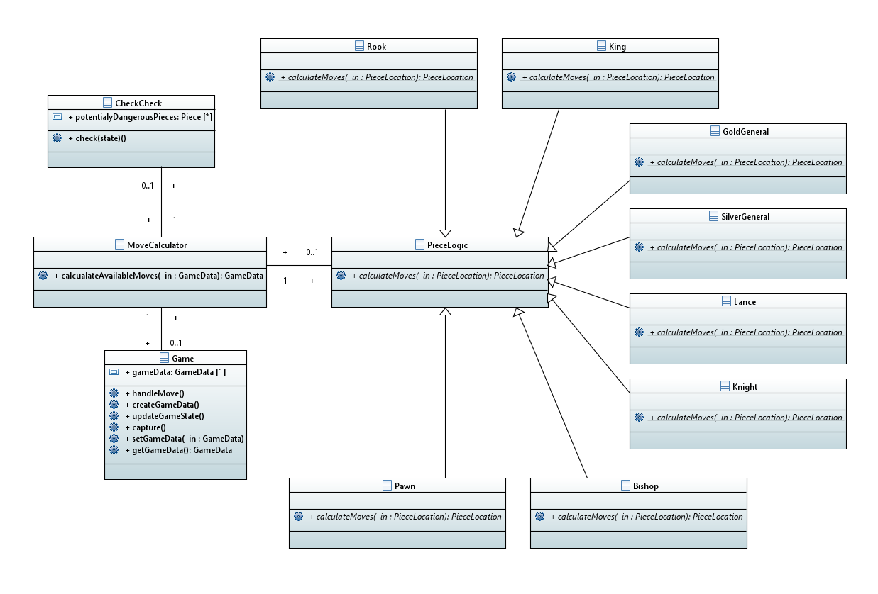
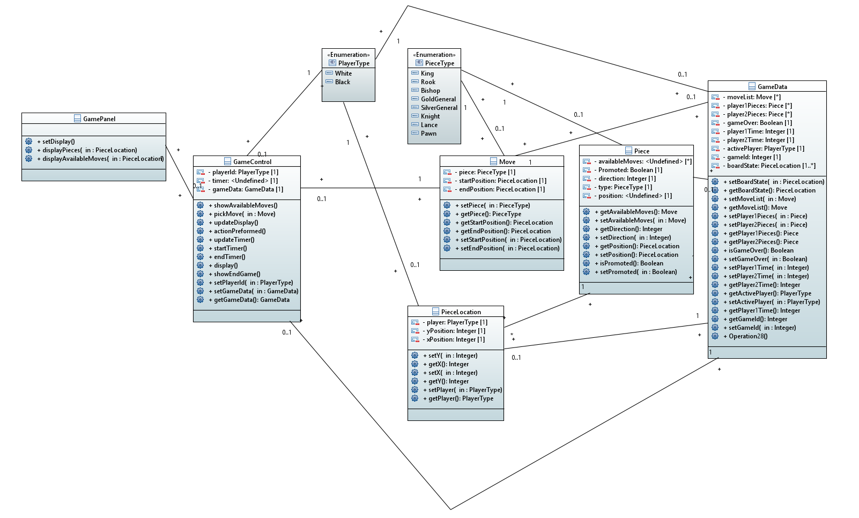
Initial Class Diagram Example

Slide 7
Final Class Diagram Example

